Slide 1

Robotics and Perception
CMSC498F, CMSC828K
Lecture 3:
Introduction to
ROS
(adapted from Todd Hester)

Slide 2
How does a robot work
Software
Perception
Cognition
Action
Hardware
Sensors
Actuators
Real World
External environment
Notes:
A robot consists of several parts:

Slide 3
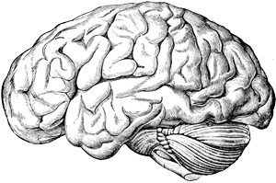
How does a robot work
Software
Cognition
Hardware
Sensors
Actuators
Real World
External environment
Notes:
A robot consists of several parts:

Slide 4
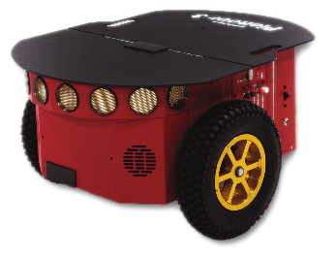
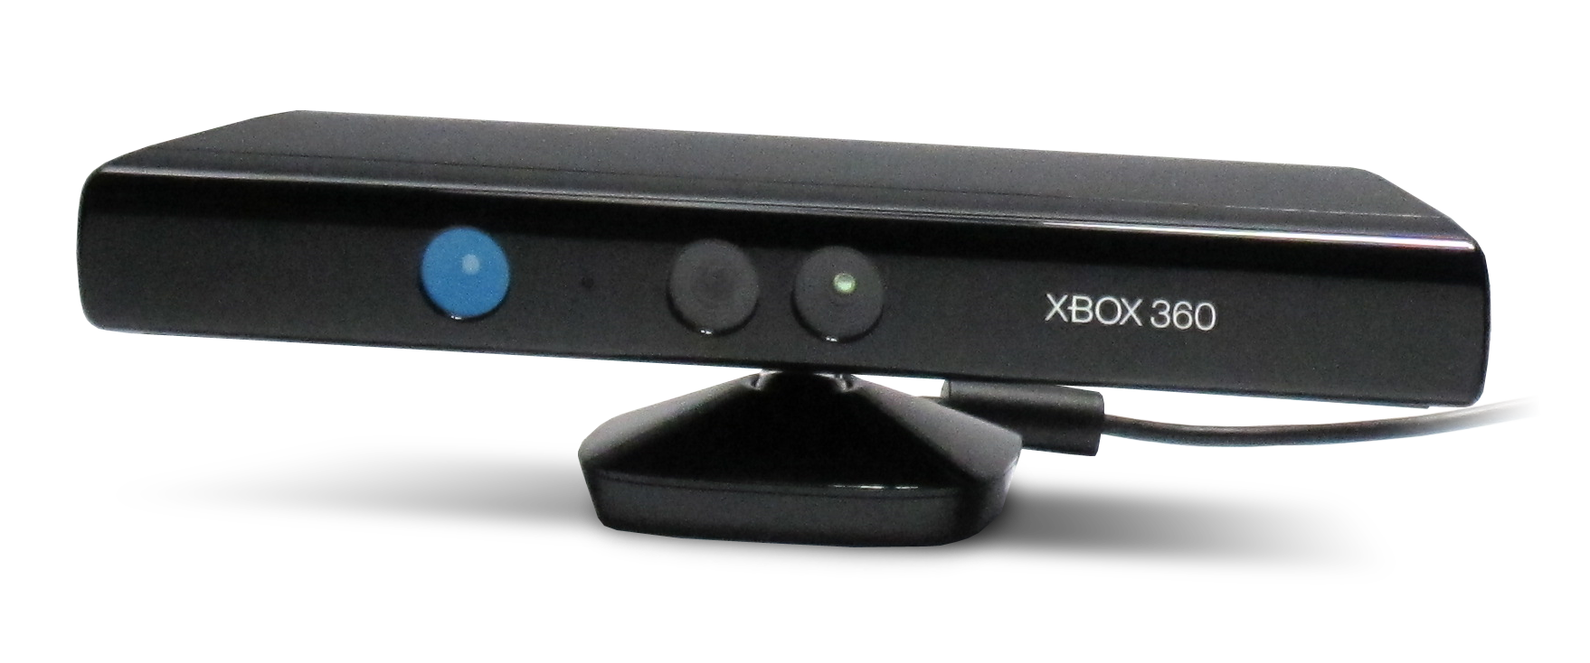
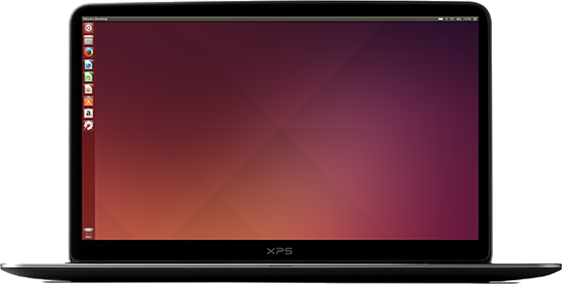
Robot example
Notes:
sensors that allow it to measure the environment around it,

Slide 5
Robot example
Notes:
sensors that allow it to measure the environment around it,

Slide 6
Controlling robots using code
Notes:
Let’s say we want our robot to follow red balls. The hardware platform is ready, we have a robot that has a camera and that can move around. How do we write the software to do it?

Slide 7
Brute force approach
Just write and compile a program to perform robot's "cognitive" functions
This program will include:
Code to interface with Kinect camera and Pioneer robot base
Code to process visual data from Kinect
Code to control the Pioneer

Slide 8
Brute force approach
Software
Kinect driver
Pioneer driver
Hardware
USB
USB
Notes:
sensors that allow it to measure the environment around it,

Slide 9

Brute force approach
Software
Problem?
Kinect driver
Pioneer driver
Hardware
USB
USB
Notes:
sensors that allow it to measure the environment around it,

Slide 10
Problems with brute force approach
What if we decide that we can get a better results using Kinect 2.0?
What if we want to share our code with a different lab, but they only have a Roomba robot, not a Pioneer?
Do we have to rewrite a big chunk of the code to accommodate a new interfaces?

Slide 11
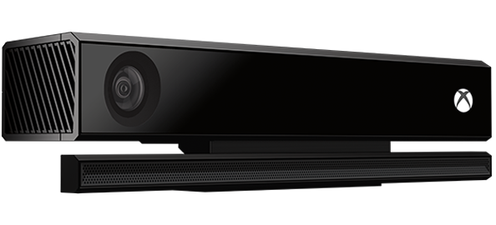
Problems with brute force approach
What if we decide that we can get a better results using Kinect 2.0?
What if we want to share our code with a different lab, but they only have a Roomba robot, not a Pioneer?
Do we have to rewrite a big chunk of the code to accommodate new interfaces?

Slide 12
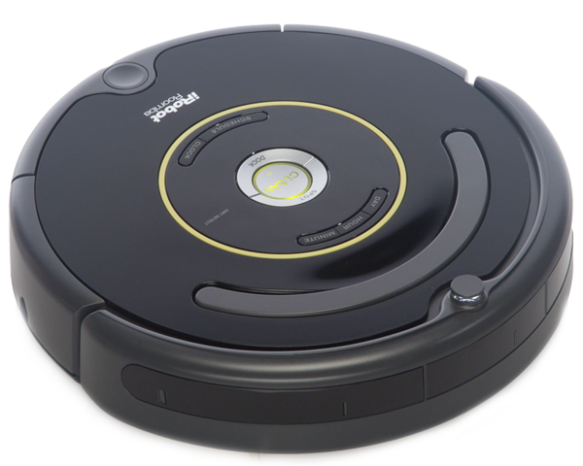
Problems with brute force approach
What if we decide that we can get a better results using Kinect 2.0?
What if we want to share our code with a different lab, but they only have a Roomba robot, not a Pioneer?
Do we have to rewrite a big chunk of the code to accommodate new interfaces?

Slide 13
Enter robotic middleware
Robotic middleware provides an abstraction layer between computation and robot hardware.
Similar to OS hardware abstraction which allows your program to work independent of the actual hardware.
i.e. hardware abstraction layer in an OS
Notes:
hardware abstraction - you as a programmer don’t care what hardware your data is coming from as long it is a certain type of data.

Slide 14
Example: a mobile platform
Software
middleware
(camera node)
middleware
(control node)
Hardware
USB
USB
Notes:
The camera middleware contains a driver for the kinect and can read it from the device and output it to the “brain” software as a standardized image. On the other hand the control node can take in commands in the form “go forward by 2 metres and rotate by sixty degrees” and can then translate it to appropriate commands for the pioneer base.

Slide 15
Example: a mobile platform
Software
middleware
(camera node)
middleware
(control node)
Hardware
USB
USB
Notes:
But the actual software that determines the behaviour of the robot didn’t change. I.e. perception stayed the same

Slide 16
Example: a mobile platform
Software
middleware
(camera node)
middleware
(control node)
Doesn’t need
to change!!!
Hardware
USB
USB
Notes:
But the actual software that determines the behaviour of the robot didn’t change. I.e. perception stayed the same

Slide 17
Advantages
Reusability
Reuse code written by other researchers and share your code with them
Portability
When you get a new robotic platform it’s easier to transfer your code to the new platform
Easier to expand functionality

Slide 18
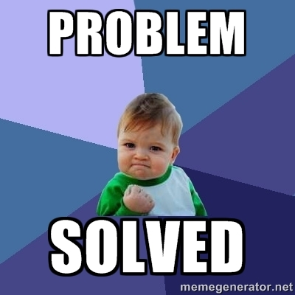
Advantages
Reusability
Reuse code written by other researchers and share your code with them
Portability
When you get a new robotic platform it’s easier to transfer your code to the new platform
Easier to expand functionality

Slide 19
Why ROS?
A number of such middleware robot frameworks exist:
Player, YARP, ROS, Microsoft Robotics Studio etc.
ROS is open source
ROS allows running processes on a distributed network and is architecture agnostic
ROS is de-facto standard in robotic community:
excellent support for hardware drivers
largest library of existing robotic algorithms (navigation, 3D perception, grasping)
vibrant online community (http://answers.ros.org/)

Slide 20
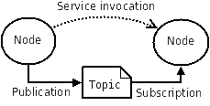
A super quick overview of ROS
Computation is distributed among many processes called nodes.
Each node is responsible for a certain robot functionality.
Nodes exchange data and using the “publish-subscribe” messaging on different “topics”.
Topics are named channels over which messages are exchanged.

Slide 21
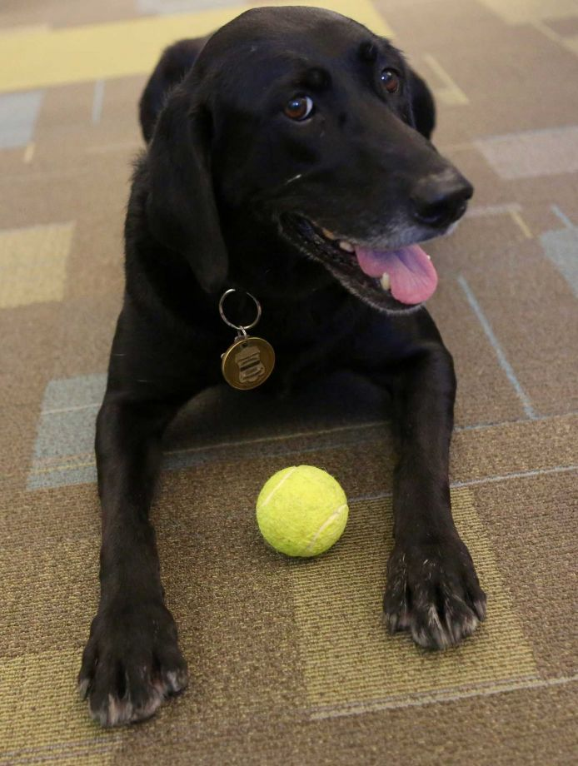

ROS example
We want a robot that goes after tennis balls
What nodes might we use?
What messages would we send?

Slide 22
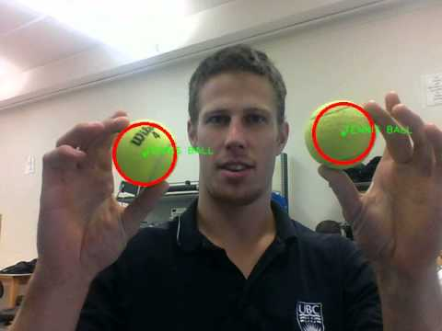
ROS example
Split the code into 4 nodes:
Camera node - produces images from the camera
Pioneer node - accepts forward and angular velocity and makes the Pioneer move
Blobfinder node - takes an image and returns the position of the tennis ball on the screen
Control node - takes the position of the tennis ball and calculates the velocities required to reach it.

Slide 23
ROS example
vision
node
control
node
camera
node
Pioneer
node
USB
USB

Slide 24
ROS example
vision
node
control
node
I will receive images on topic "image" and publish blobs on topic "blobs"
I will receive blobs on topic "blobs" and publish velocities on topic "cmd_vel"
ROS
master
I will publish images on topic "image"
I will receive velocities on topic "cmd_vel"
camera
node
Pioneer
node
USB
USB

Slide 25
ROS example
vision
node
blobs on “blobs”
control
node
images on “image”
ROS
master
velocities on “cmd_vel”
camera
node
SETS UP COMMUNICATION BETWEEN NODES
Pioneer
node
USB
USB

Slide 26
ROS is not...
ROS is a system for controlling robots from a PC.
ROS is not:
a computer OS. ROS runs under Ubuntu, Windows, OS X, Android (however highest compatibility with Ubuntu)
a programming language. You can write code with ROS in Python, C++ and other languages
a library. However, a lot of important robotic algorithms have implementations in ROS
an IDE. You can write code for ROS in any IDE or text editor)

Slide 27
Packages
All software in ROS is organized in packages.
Each package can define multiple nodes.
A valid ROS package must have a specific structure:
/package_name
CmakeLists.txt (tells CMake how to bui)
Package.xml (a description of what’s in the package)
/src
/node1.py (Python node 1)
/node2.py (Python node 2)
...
Notes:
Package is an organizational unit of

Slide 28
Packages: useful commands
To create a new package:
catkin_create_pkg package_name
ROS can find packages for you
rospack find package_name (print location of a package)
roscd package_name (change directory to package folder)
rosls package_name (list contents of package folder)
To find the packages ROS checks the subfolders of the paths stored in the environment variable ROS_PACKAGE_PATH
$ echo $ROS_PACKAGE_PATH
/opt/ros/indigo/share:/opt/ros/indigo/stacks:
/home/aecins/ros
Notes:
Package is an organizational unit of

Slide 29
Nodes
A node is a process that performs some computation.
A robot control system will usually comprise many nodes each having a specific function.
Nodes can be named, so that multiple instances of a node can be running at the same time.
Useful commands:
rosrun package_name executable_name (launch an instance of a node)
rosnode list (get a list of active nodes)
rosnode ping /nodename (test connectivity to node)
rosnode info /nodename (information about a node)

Slide 30
Topics and messages
The primary mechanism for inter node communication is message passing.
Topics are named buses over which nodes exchange messages.
A topic is defined by it’s name and the type of message it uses.
A node can:
publish messages to a topic (output)
subscribe to a topic to read messages (input)
Common message types:
std_msgs/String
std_msges/Int32
sensor_msgs/Image
...

Slide 31
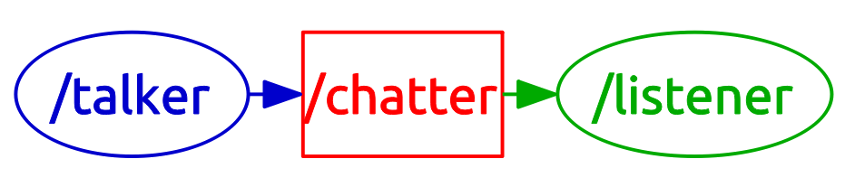
Topics and messages: example
There are two nodes:
/talker
/listener
/talker publishes messages of type std_msgs/String to topic /chatter
/listener subscribes to topic /chatter

Slide 32
Topics and messages: useful commands
Topics:
rostopic list (get a list of active topics)
rostopic info /topic_name (get information about topic)
rostopic type /topic_name (get the type of message used by the topic)
rostopic echo /topic_name (print messages published on a topic)
rostopic pub /topic_name (publish a message to a topic)
Messages:
rosmsg show message_type (show the format of a message type)

Slide 33
Publisher example
1 #!/usr/bin/env python 2 import rospy 3 from std_msgs.msg import String 4 5 def talker(): 6 rospy.init_node('talker', anonymous=True) 7 pub = rospy.Publisher('chatter', String, queue_size=10) 8 rate = rospy.Rate(10) # 10hz 9 while not rospy.is_shutdown(): 10 hello_str = "hello world %s" % rospy.get_time() 11 rospy.loginfo(hello_str) 12 pub.publish(hello_str) 13 rate.sleep() 14 15 if __name__ == '__main__': 16 try: 17 talker() 18 except rospy.ROSInterruptException: 19 pass

Slide 34
Subscriber example
1 #!/usr/bin/env python 2 import rospy 3 from std_msgs.msg import String 4 5 def callback(data): 6 rospy.loginfo(rospy.get_caller_id() + "I heard %s", data.data) 7 8 def listener(): 9 rospy.init_node('listener', anonymous=True) 10 rospy.Subscriber("chatter", String, callback) 11 12 # spin() simply keeps python from exiting until this node is stopped 13 rospy.spin() 14 15 if __name__ == '__main__': 16 listener()

Slide 35
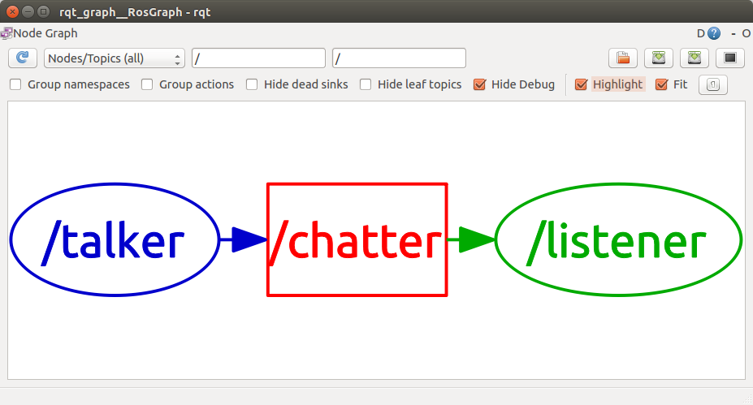
Visualizing nodes and topics
ROS has a built in tool to visualize node connectivity.
To launch it:
rosrun rqt_graph rqt_graph

Slide 36
Logging
rosbag allows to record all of the topics and time stamped messages that were published on these topics over a period of time.
Recorder data is stored in .bag files.
Playing back a bag file “reproduces” the recorded ROS system
Usage:
rosbag record -a (start recording all topics)
rosbag info bag_filename (get information about a bag file)
rosbag play bag_filename (playback recorded data)

Slide 37
A quick demonstration...

Slide 38
More things...
ROS environment
Package dependencies
Compiling packages
Services

Slide 39

Installation
It is strongly recommended to install it under Ubuntu.
For this course we are using ROS version Indigo.
Installation instructions can be found here:
http://wiki.ros.org/indigo/Installation/Ubuntu
If you are doing a clean install of Ubuntu we have an Ubuntu distribution with ROS Indigo preinstalled.

Slide 40
Assignment 0
Best way to learn is to do it yourself:
Install ROS on your machine
Go through ROS beginner tutorials 1-18 http://wiki.ros.org/ROS/Tutorials (using Python)
Assignment details with deliverables will be posted on the website today 02/09.
Assignment due next Tuesday 02/16.

Slide 41
Tips and tricks
If something doesn’t work - restart roscore
If it is still broken - restart your computer
Don’t forget to make your Python scripts executable
chmod +x script_name
Use ROS cheat sheet: https://github.com/ros/cheatsheet/releases/tag/0.0.1
Don’t hesitate asking for help:
Me, Cornelia
fellow students
http://answers.ros.org/

Slide 42
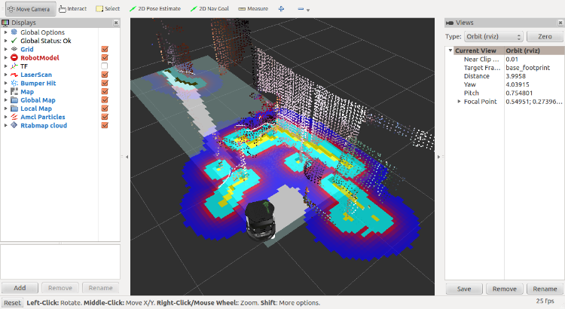
Next time on ROS
Representing robot model and state
3D visualization tool for monitoring robot state
Robot simulation
Turtlebot robot!

Slide 43
The end!
Questions?

